Slide 1



BMW CASE STUDY
Customer Purchase Data

Slide 2

Content
Data Exploration
Patterns
Interest
Future Scope
Prediction
Problem Statement

Slide 3
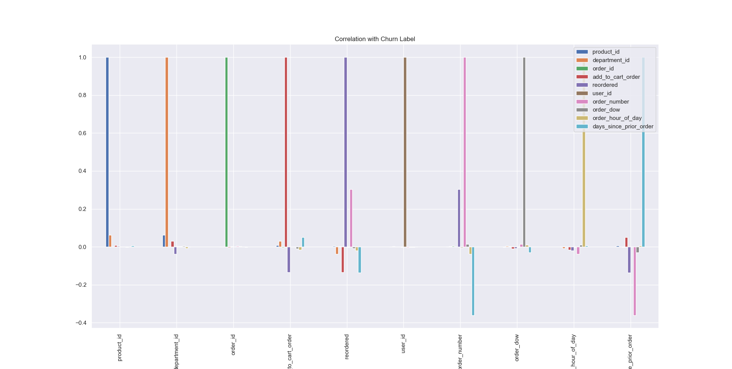
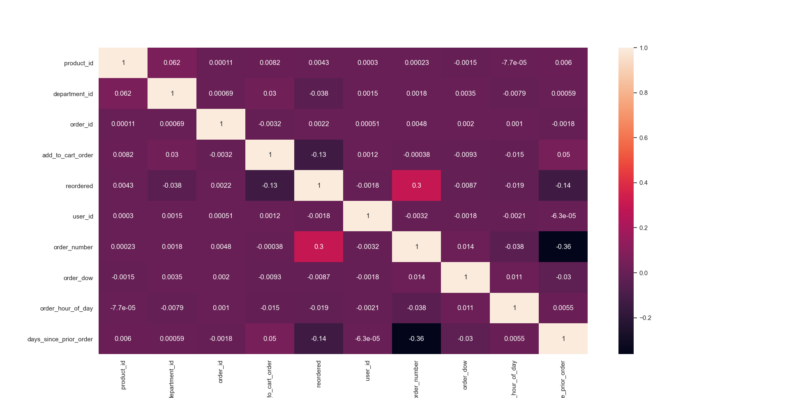
Data Exploration
Joined all CSV’s together
Not highly co-related
‘Reordered’ and ‘order number’ co-related +vely while ‘order numbe’r and ‘days_since_prior_order’ is –vely corelated max out of all columns

Slide 4

Problem Statement
To analyze and provide analytics from the raw data of customer buying products
To check if there could be a correlation to help us in prediction?
Are there any other parameters that can predict better?
Predictions

Slide 5
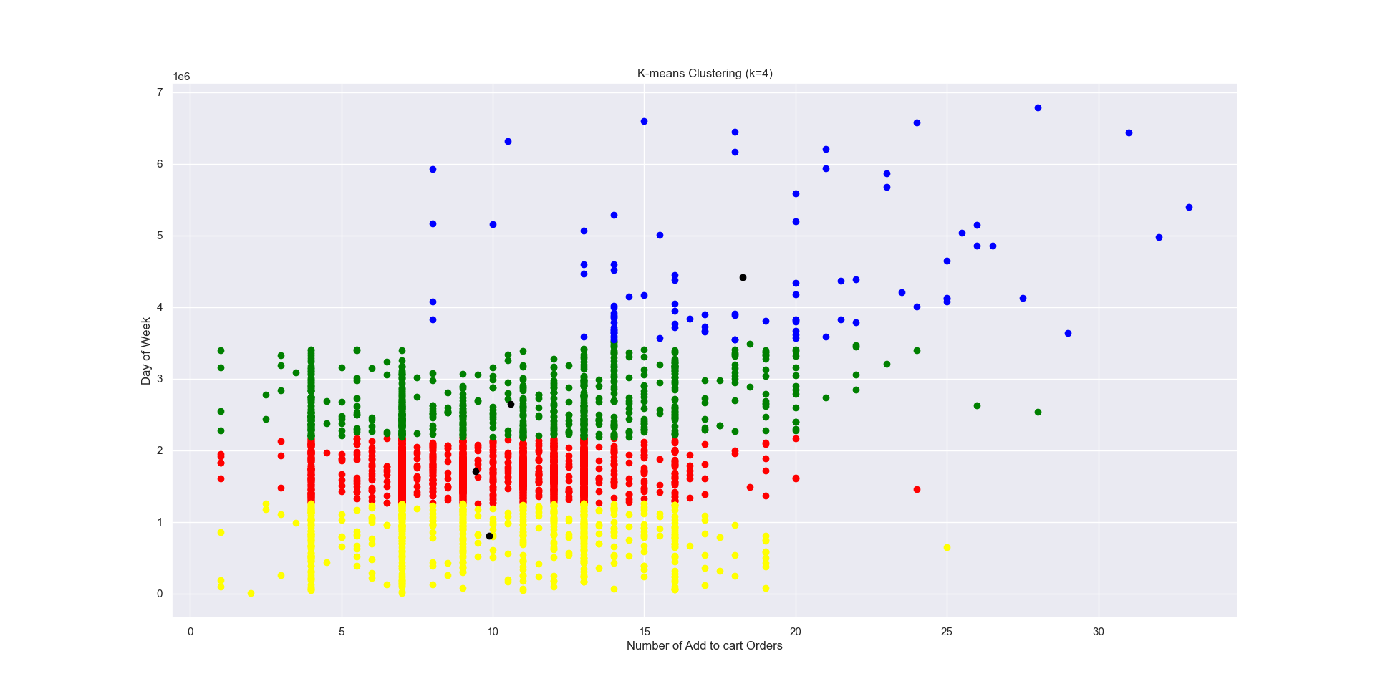
Patterns
Orders v/s Day of Week
Most Quantity orders: 4 Business days
Most Number of Orders: Weekends
Large Orders usually at Night
4 clusters

Slide 6
Interest
Maximum Orders: Fresh Fruits [Product]
Maximum Orders: Indian Foods [Department]

Slide 7
Prediction
Standard Deviation: 0.16 %
TPR = 0.0
TNR = 1.0
Accuracy = 99.06%
Average Accuracy using 10-fold Cross validation = 98.69%
precision recall f1-score support
0 0.99 1.00 1.00 1377
1 0.00 0.00 0.00 13
accuracy 0.99 1390
macro avg 0.50 0.50 0.50 1390
weighted avg 0.98 0.99 0.99 1390
####### Confusion Matrix
[[1377 0]
[ 13 0]]
Area Under Curve 0.5

Slide 8

Future Scope
If Order ID is input, we can Assume the number of orders if it’ll me more than Average (17 orders) or not

